Slide 1
Crimes in Los Angeles
Husain Mohamed Redha Hubail

Slide 2




Problem and Story

Slide 3
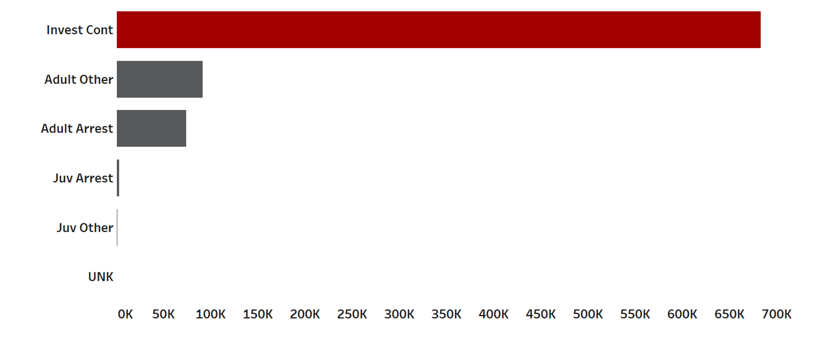
The most of crimes are under investigation !!

Slide 4




Key Factors
WHEN
WHERE
The crimes are active and what type?
The high concentration of crimes?
WHAT
DANGEROUS
Are the top crimes in this area?
Crimes with weapon

Slide 5
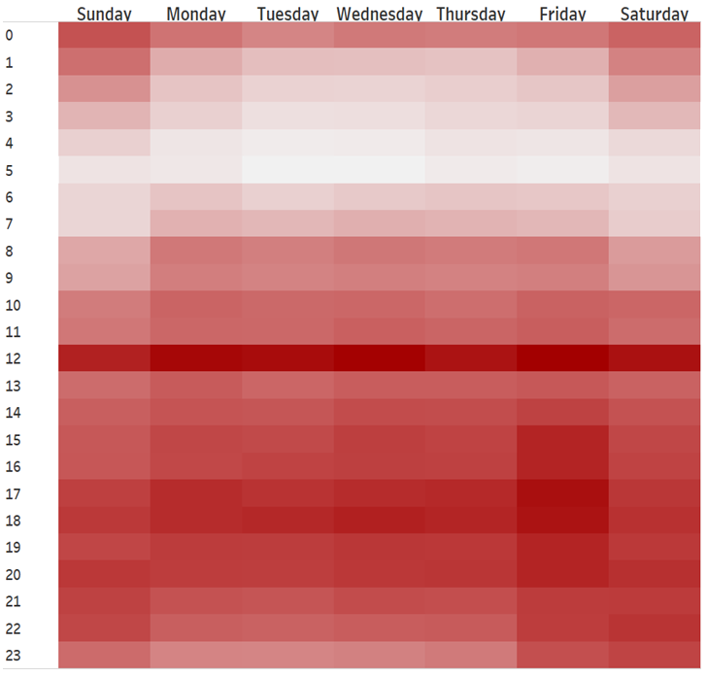

High Concentration of Crimes
12 pm

Slide 6
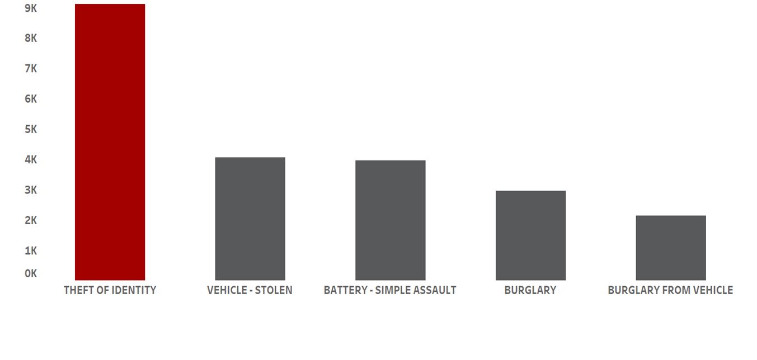
High Theft of Identity at 12 pm

Slide 7
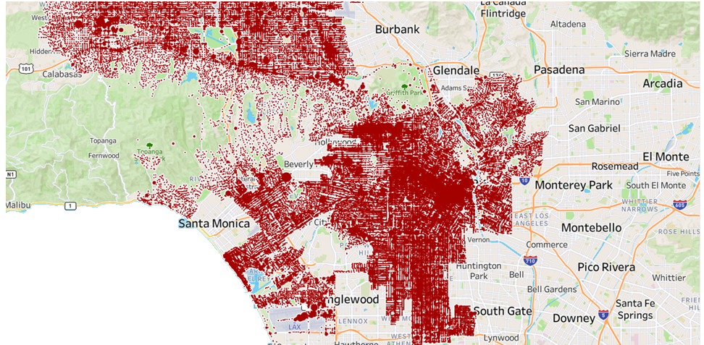
High Concentration in Central & Rampart

Slide 8
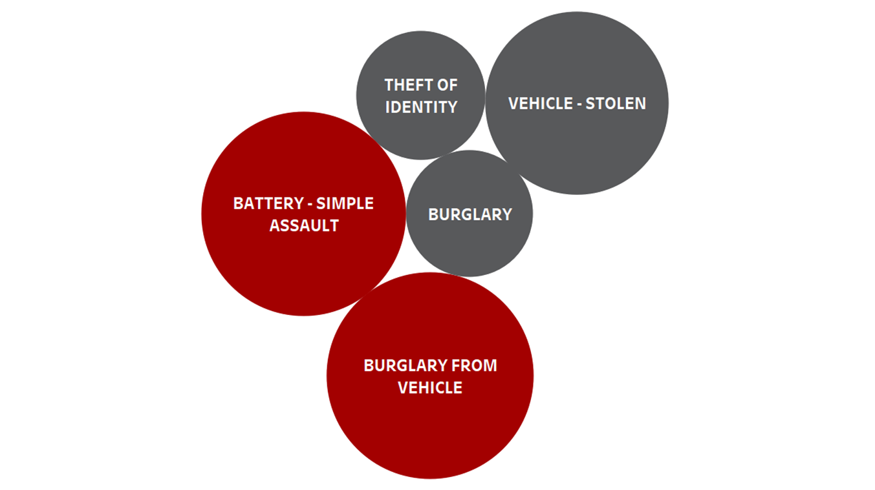
Top 5 Crimes in Central & Rampart

Slide 9

Burglary From Vehicle by Victim Race
White
Hispanic
Other
Black
32.14%
30.42%
23%
14.44%

Slide 10

60 % of Burglary From Vehicle Victims are Male
60 %
40%

Slide 11
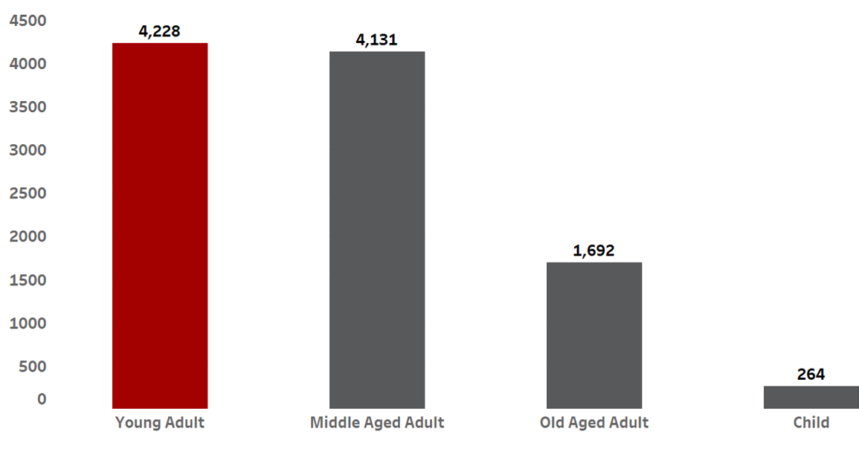
Young Adults are the Most Victims in Burglary From Vehicle

Slide 12

Half of Battery Simple Assult Victims are Hispanic
Hispanic
Black
Other
White
50.35%
22.61%
10.71%
16.32%

Slide 13
57% of Battery Simple Assult From Vehicle Victims are Male
57 %
43%

Slide 14
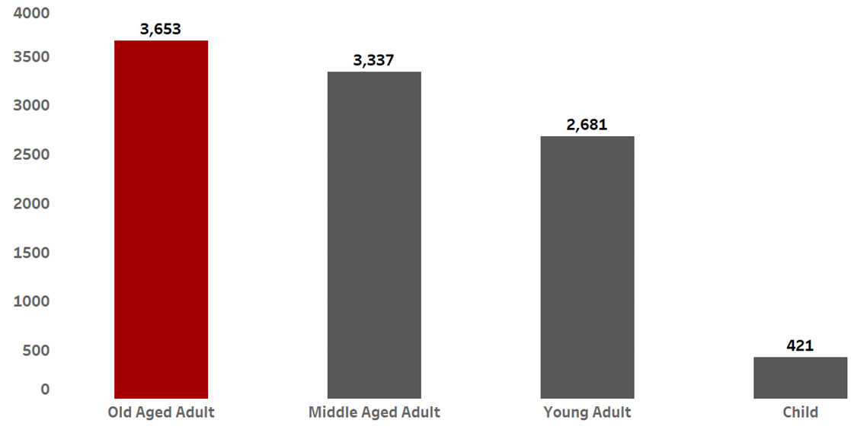
The Most of Battery Simple Assult From Vehicle Victims are Elderly

Slide 15
Guns & Knifes

Slide 16
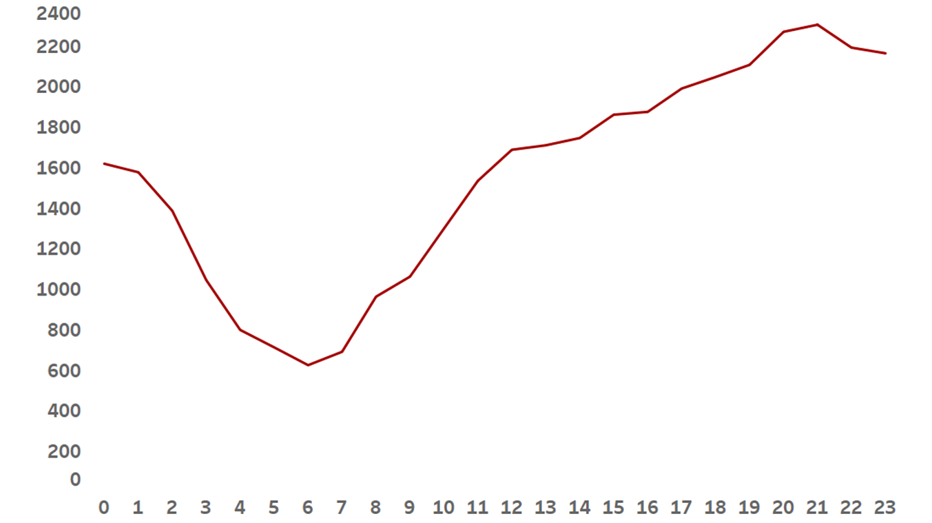
High number of Crimes at Night

Slide 17
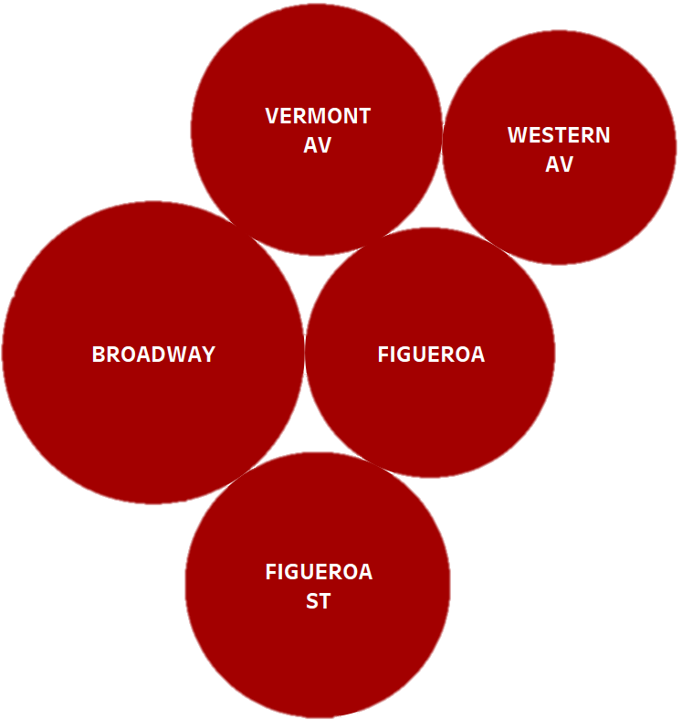
Top Streets where Armed Crimes are Committed

Slide 18
Wrap Up !!
High Noon Crime Surge: The busiest hour for crimes is 12 PM, driven largely by a spike in identity theft incidents.
Crime Hotspots: Central and Rampart stand out as the epicenters of criminal activity, with these areas seeing the highest number of offenses.
Top Offenses in These Areas:
Battery Simple Assault
Burglary from Vehicle
Danger After Dark: The most dangerous crimes tend to happen between 7 PM and midnight, when the streets become riskier and more severe offenses occur

